Slide 1
THE HUNGRY SNAKE
Section: K19JC
Course Code: INT213
Degree: B.tech CSE

Slide 2
Group Members
Name | Reg. No | Roll No.
Ravi Shankar Nayak | 11908621 | 65
Arjun Shyam | 11908581 | 68
Abhay Prathap Singh | 11908655 | 63

Slide 3
Contents
Topic | Pg. No.
Acknowledgement | 4
Abstract | 5
Introduction | 6
Project Contribution | 7
Screenshots | 10
Conclusion | 14
Bibilogy | 15

Slide 4

Acknowledgement
We would like to express our special thanks of gratitude to our teacher Mr.Sagar Pande who gave us the golden opportunity to do this wonderful project on the topic ‘The Hungry Snake’, which also helped us in doing a lot of research and we came to know about so many new things, we are really thankful.

Slide 5
Abstract
This project was developed with at most care and concern by the team members for python programming using Pygame along with our Twilio API Integration.
The Hungry Snake is a world famous and evergreen game, which can be played by anyone of any age [no age restrictions], but we modified this game into a brand new level by merging up the API integration along with the game and last but not least this time we made the game for the ones who love playing a game in its multiplayer version – the Multiplayer version.
Now all you have to do is give the Hungry Snake your WhatsApp number, select the version – single player or Multiplayer and then rock n roll, and at the end of the game you will receive your score in your given mobile number.

Slide 6
Introduction
Our goal in this project is to create a multiplayer Snake game having Twilo API integration. This project is totally made with python programming language and pygame module.
Pygame is a cross-platform set of python modules designed for writing video games. By using this, we have developed two categories of the game, one is single player mode and the other is 2-player (multiplayer) mode. It also has a feature of playing or pausing Background music.
It also has the API Integration feature. For this we have used Twilio API Integration. By the help of this, the user receives a WhatsApp message of what score he/she gets after playing this game.

Slide 7

Project Contributions
This project would not have been successful without the valuable contribution of the team members.
Their individual contribution is listed below:
Ravi Shankar Nayak
Contribution:
Single Player Mode, API Integration
Methods used:
random.randint()
pygame.event.get()
pygame.draw.circle()
blit()
append()
display.update()
clock.tick()
twilio.rest module
Client module of Twilio
Client.message.create()

Slide 8

Project Contributions
2. Arjun Shyam
Contribution:
Multiplayer mode, Project Report, Project Presentation
Methods used:
pygame.event.get()
pygame.mouse.get_pos()
pygame.mouse.get_pressed()
pygame.draw.rect()
blit()
fill()
pygame.display.update()
MS Word
MS Powerpoint

Slide 9

Project Contributions
2. Abhay Prathap Singh
Contribution:
Game Interface, Game Music
Methods used:
pygame.display.set_mode()
pygame.image.load()
pygame.display.set_icon()
pygame.mixer.init()
pygame.mixer.music.load()

Slide 10
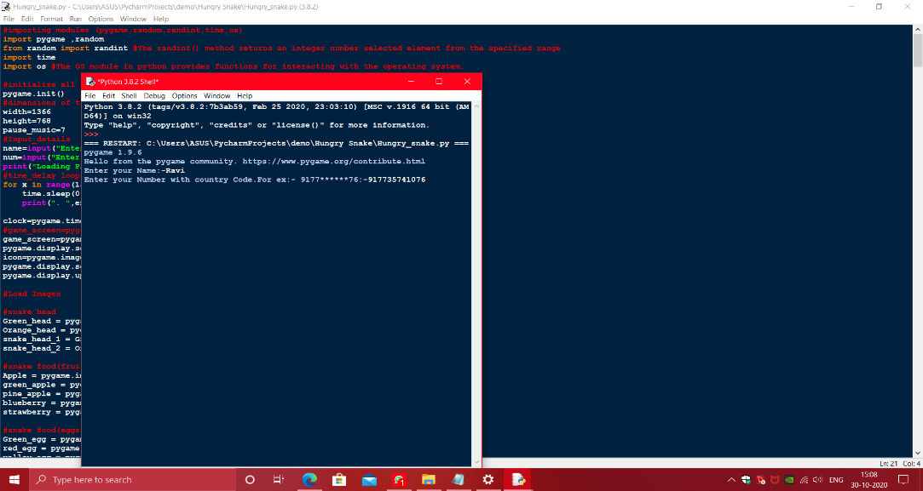

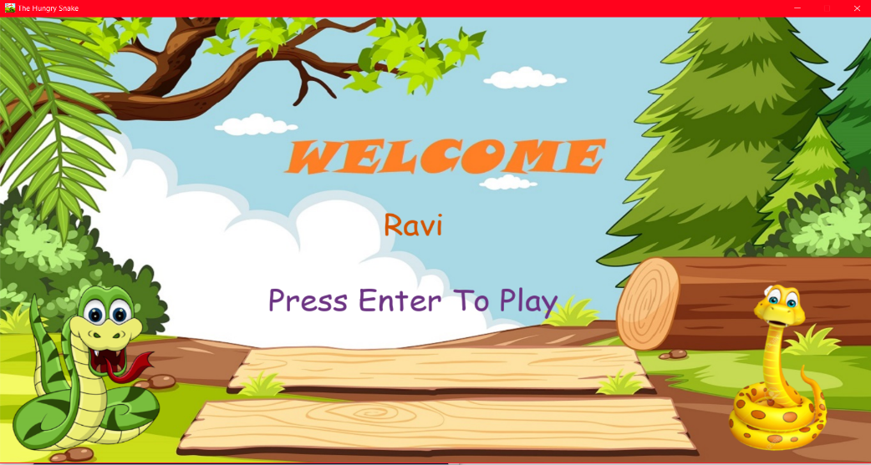
Screen Shots

Slide 11
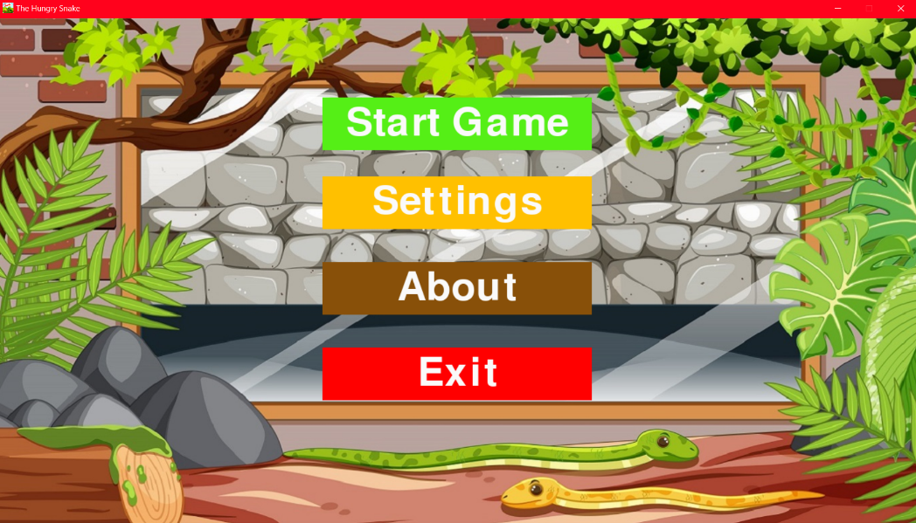

Screen Shots

Slide 12
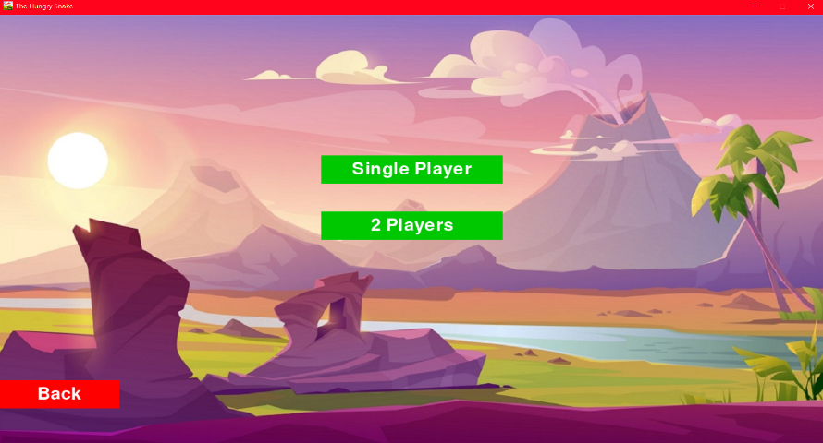
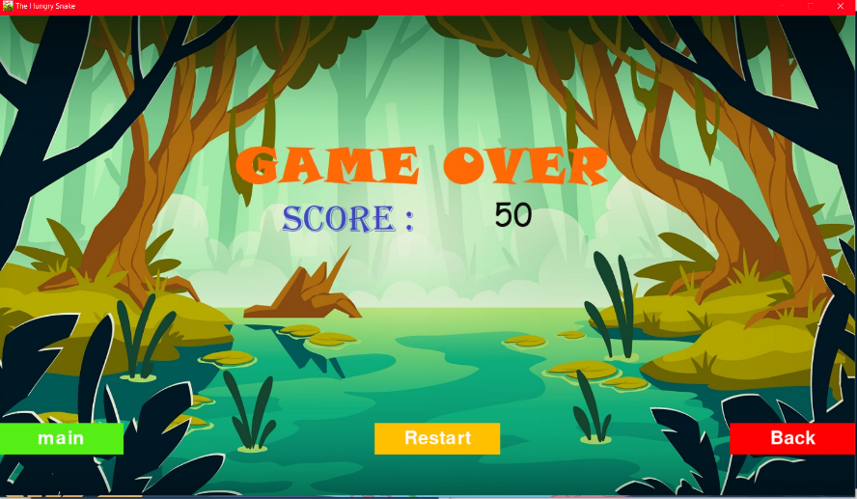
Screen Shots

Slide 13
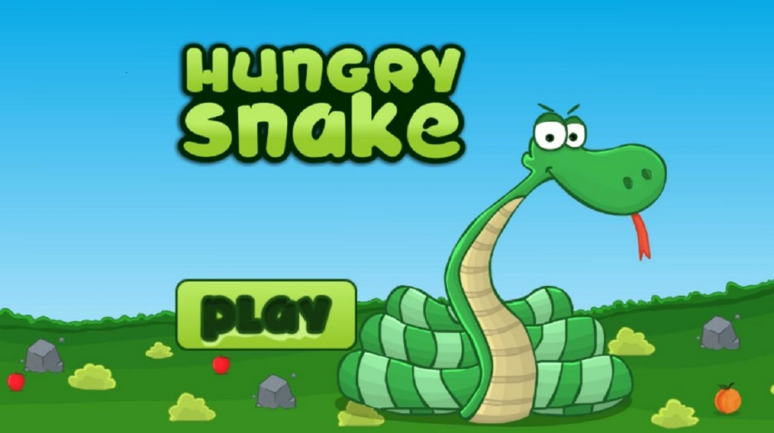
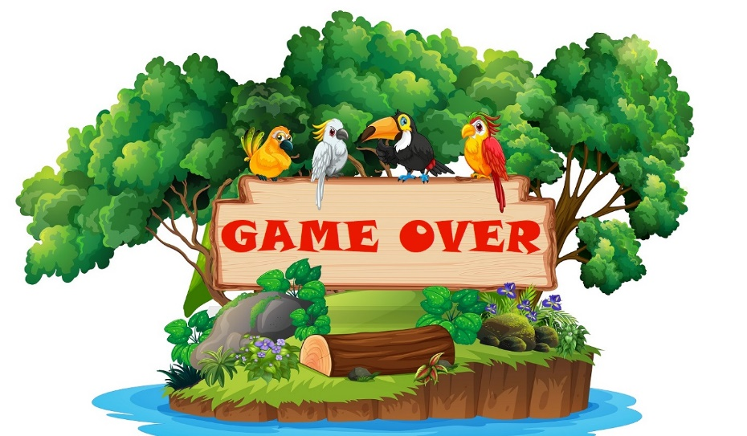
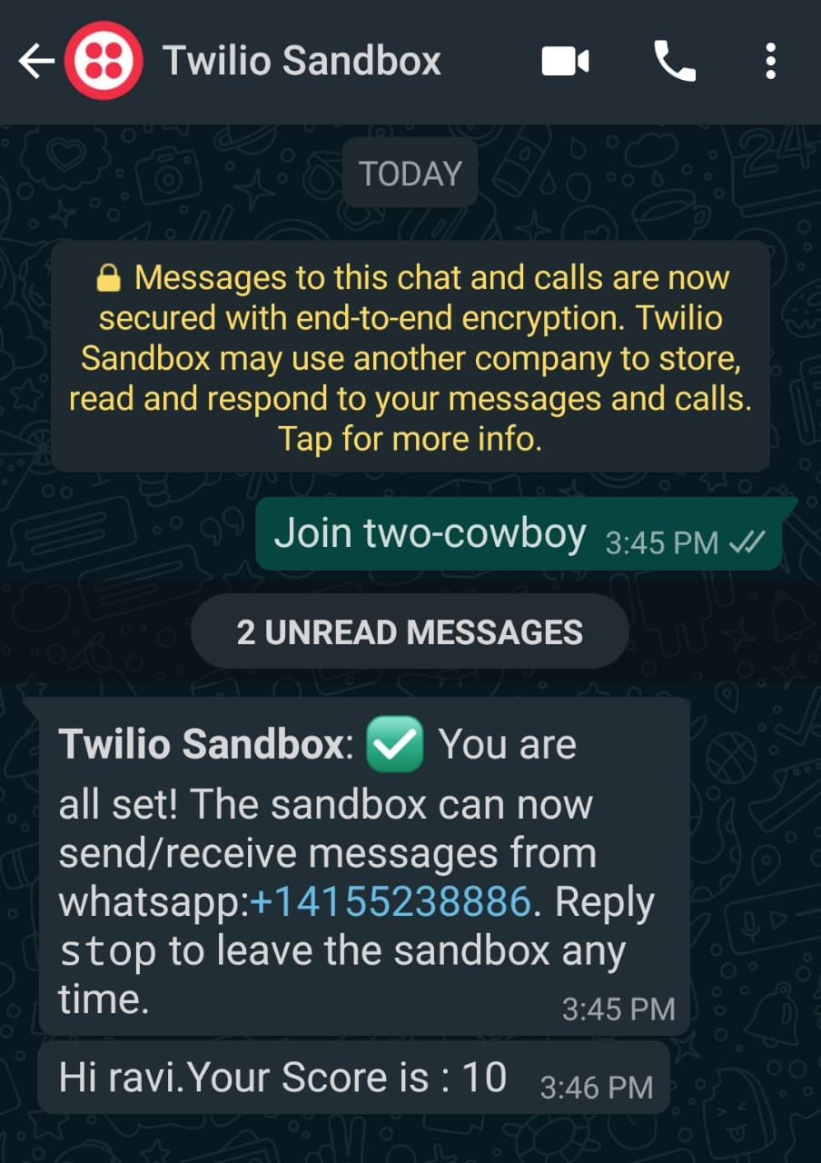
Screen Shots

Slide 14
Conclusion
1000’s of games get released a year , including big games and small ones, the matter is not if the game is big or small, what matters the most is if the people loves the game or not, this was our moto .. So we made the game as much user friendly as possible along with that, we made it more colourful.
Pygame has a major role in this project.

Slide 15
Bibilogy
These are the websites we went through in order to make this project:
www.pygame.org
www.python.org
www.freepik.com
www.realpython.org
www.geeksforgeeks.org/pygame

Slide 16
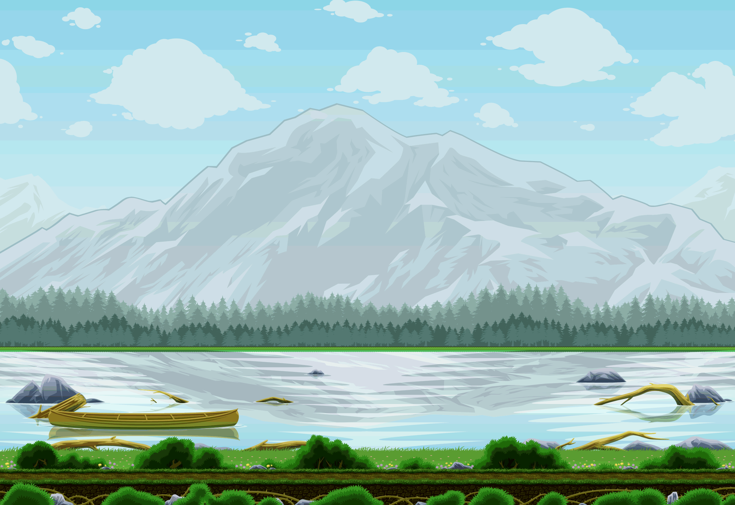













Have a nice day

